Slide 1
Containers on AWS
Notes:
[Introduce yourself]
Confused between all your choices of containers services you can run on AWS? This session will explore your options and the advantages of each.
Whether you are just beginning to learn Docker or are an expert with Kubernetes, join us to learn how to pick the right services that would work best for you.

Slide 2
Agenda
Introduction
Amazon ECR – container registry
Amazon EKS – Kubernetes
Amazon ECS – Nice and easy container orchestration
AWS Batch – scheduler and orchestration for batch jobs
AWS CodePipeline – CI/CD pipeline
Other ways to run container on AWS
New Services!
Notes:
- - Today, I am going to talk about:
Why companies are moving to containers
What customers are building on AWS
How customers are building on AWS
Internet2 workshop intensive
Workshop Intensive Schedule (duration) [end time]:
Settle and welcome (5 min)
Introduction to containers and all available containers services (5-8 slides, 10 min) [0:15]
Overview of hosted Kubernetes service (10-15 slides, 15 min) [0:30]
Overview of alternative container services/batch (10-15 slides, 15 min) [0:45]
Overview of container build pipelines (CI/CD) (10-15 slides, 15 min) [1:00]
Break (15 min) [1:15]
Lab session (45 min) [2:00]
Break (15 min) [2:15]
Questions and discussion (30 min) [2:45]
Close (15 min) [3:00]
Closing Remarks ~ 5 min
Podium time ~5-10 min
Overflow time (1 hour) [4:00]

Slide 3
Introduction

Slide 4




Application environment components
Runtime Engine
Code
Dependencies
Configuration

Slide 5

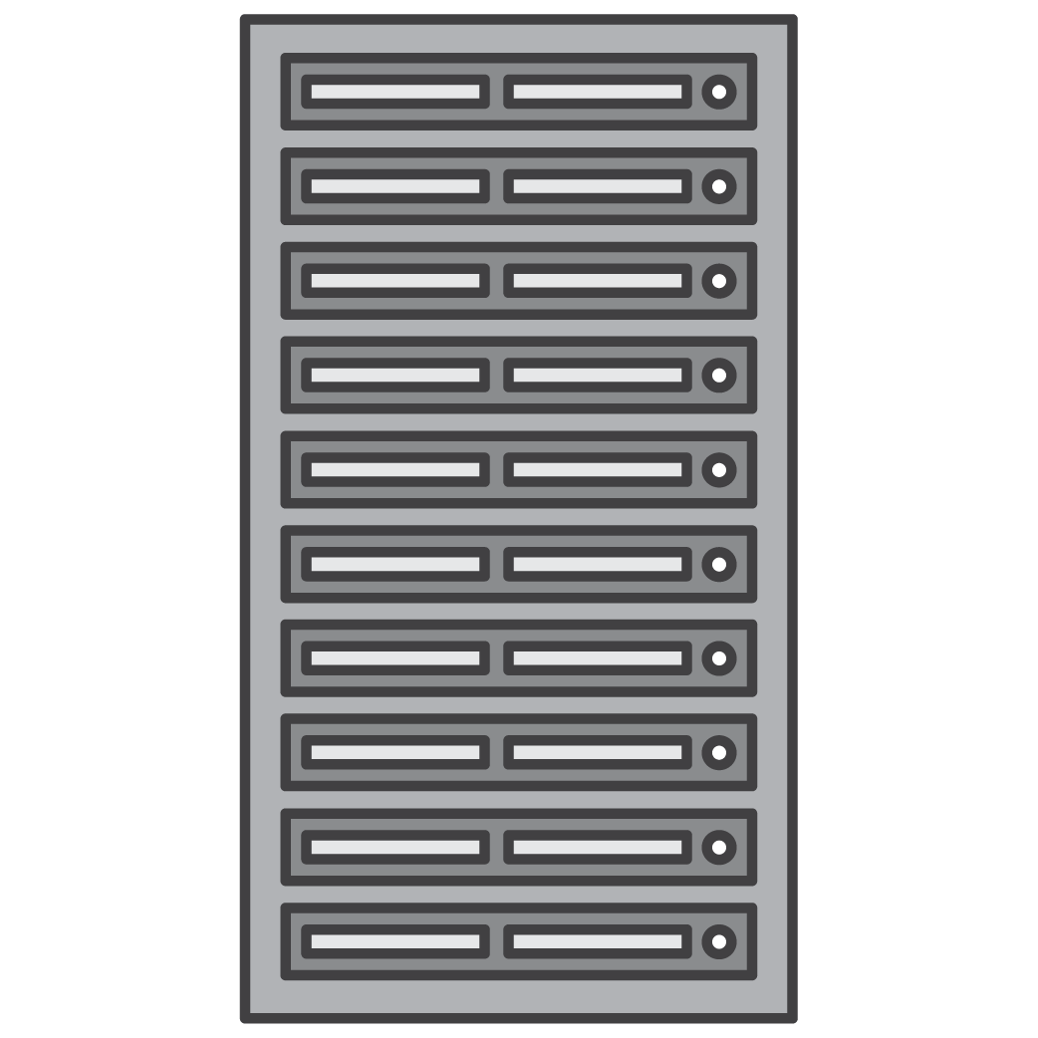
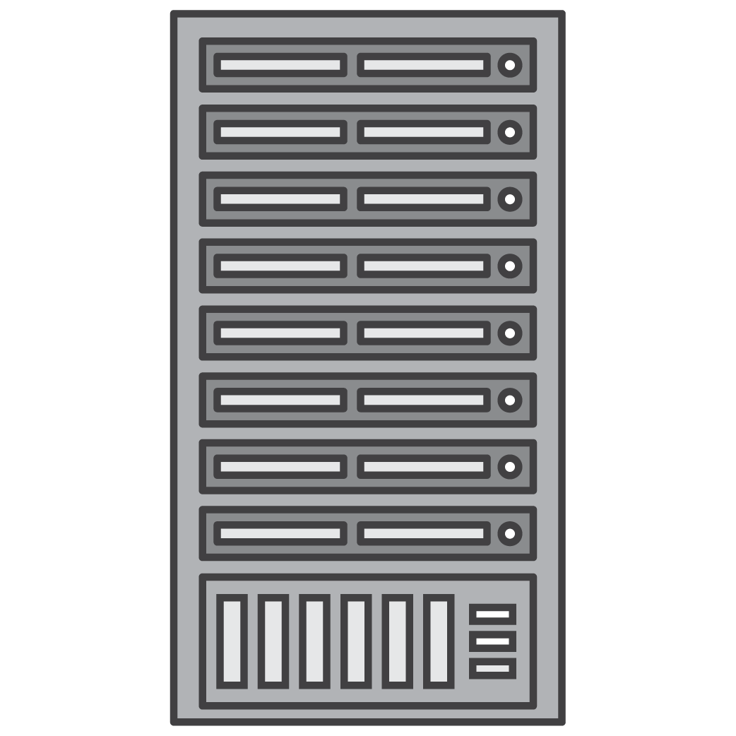
It worked on my machine, why not in prod?
v6.0.0
v7.0.0
v4.0.0
v7.0.0
Local Laptop
Staging / QA
Production
On-prem

Slide 6
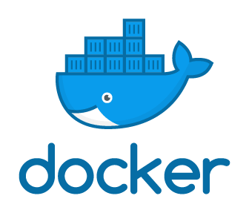
Docker to the rescue
Runtime Engine
Dependencies
Code

Slide 7
Docker container image
Read only image that is used as a template to launch a container.
Start from base images that have your dependencies, add your custom code.
Docker file for easy, reproducible builds.
Writable
add ngix
Container
add nodejs
Image
References
parent
image
Ubuntu
Image
Base image
bootfs
kernel

Slide 8
Four environments, same container
Local Laptop
Staging / QA
Production
On-Prem

Slide 9
Virtual machine versus Docker
VM
App 2
App 1
App 2
App 3
Container
Bins/Libs
Bins/Libs
Bins/Libs
App 1
App 2
App 3
Guest OS
Guest OS
Guest OS
Bins/Libs
Bins/Libs
Bins/Libs
Hypervisor
Docker
Host OS
Host OS
Server (Host)
Server (Host)

Slide 10
Why customers adopt containers
Reduced risk
Uniform security across environment, maintained with automation
Operational efficiency
Reduced operational burden by removing undifferentiated heavy lifting
Consistent environment improves developer velocity
Speed
Agility
Automation increases speed and ease of testing and iterating
Notes:
Because of these customer needs, we’ve seen a large push toward containers.
by letting AWS handle infrastructure and operational burden and provide automation, customers are able to reduces risk and focus on building business logic instead of infrastructure
By moving to a controlled and repeatable environment and embracing automation, we see product delivery velocity dramatically increase, while improving quality, stability, and security

Slide 11
The containers stack on AWS
CONTAINERS
HYBRID ARCHITECTURE
SECURITY, IDENTITY, & COMPLIANCE
DEV TOOLS
CONTAINER SERVICE
MANAGED KUBERNETES
STORE & RETRIEVE DOCKER IMAGES
AWS-SERVICES ON-PREMISES
DATA INTEGRATION
INTEGRATED DEVICES & EDGE SYSTEMS
INTEGRATED IDENTITY & ACCESS
INTEGRATED NETWORKING
INTEGRATED RESOURCE & DEPLOYMENT MANAGEMENT
VMWARE CLOUD ON AWS
ANALYSE & DEBUG
APPLICATION LIFECYCLE MANAGEMENT
AUTHORING
BUILD & TEST
CONTAINERS
DEVOPS RESOURCE MANAGEMENT
ONE CLICK APP DEVELOPMENT
PATCHING
PIPELINE ORCHESTRATION
RESOURCE TEMPLATES
TRIGGERS
ACCESS CONTROL
ASSESSMENT & REPORTING
CONFIGURATION COMPLIANCE
DATA PROTECTION
DDOS PROTECTION
IDENTITY MANAGEMENT
KEY MANAGEMENT & STORAGE
MONITORING & LODGING
RESOURCE MANAGEMENT
THREAT DETECTION
WEB APPLICATION FIREWALL
THREAT DETECTION & INVESTIGATION FOR AMAZON DETECTIVE
AUTOMATED SECURITY POSTURE CHECKS FOR AWS SECURITY HUB
COMPUTE
AUTO SCALING
BATCH JOBS
EVENT-DRIVEN SERVERLESS COMPUTING
INSTANCE TYPES
MANAGED VIRTUAL PRIVATE SERVERS
MANAGED REPOSITORY FOR SERVERLESS APPS
RUN & MANAGE WEB APPS
SERVERLESS COMPUTE
VIRTUAL SERVERS
ISOLATED COMPUTE ENVORNMENTS (FOR NITRO ENCLAVES)
INFRASTRUCTURE
AVAILABILITY ZONES
CUSTOM HARDWARE
DATA CENTER INFRASTRUCTURE
GLOBAL NETWORK BACKBONE
POINT OF PRESENCE
POWER INFRASTRUCTURE
REGIONS
MOBILE
API GATEWAY
DEVELOPMENT FRAMEWORK
IDENTITY
MOBILE ANALYTICS
MOBILE APP TESTING
SINGLE INTEGRATED CONSOLE
SYNC
TARGETED PUSH NOTIFICATIONS
MANAGEMENT & GOVERNANCE
NETWORKING & CONTENT DELIVERY
STORAGE
ACTIVITY & API USAGE TRACKING
CHATBOT
CONFIGURATION TRACKING
GOVERNANCE
INVENTORY TRACKING
LICENSE MANAGER
MANAGE POLICIES
MANAGE RESOURCES
MONITORING
PROVISIONING
RESOURCE TEMPLATES
SECURITY RECOMMENDATIONS
SERVER MANAGEMENT
SERVICE CATALOG
SYSTEM MANAGER
APPLICATION DELIVERY
DEDICATED NETWORK CONNECTION
DOMAIN NAMING SERVICE
LOAD BALANCING
MONITOR APIS
MONITOR MICROSERVICES
NETWORK TOPOLOGY
NETWORKING HUG
PRIVATE CONNECTION TO APPS
SCALE VPS & ACCOUNT CONNECTIONS
SERVICE DISCOVERY
VIRTUAL PRIVATE CLOUD
ARCHIVE STORAGE
BACKUP & RESTORE
BLOCK STORAGE
DATA TRANSFER
EDGE PROCESSING & COMPUTING
FILE STORAGE
HIGH PERFORMANCE FILE SYSTEM
HYBRID CLOUD STORAGE
OBJECT STORAGE
WINDOWS FILE SYSTEM
APPLICATION INTEGRATION
EMAIL
MESSAGE BROKER
QUEUING & NOTIFICATIONS
SEARCH
TRANSCODING
WORKFLOW
Notes:
AWS has the broadest set of services, technologies and tools to build applications on containers, as well as deep integrations with open source and AWS partner technologies.
There is no one right way to build on AWS, and indeed our larger customers build in multiple ways, using both ECS and EKS, and container and non-container technologies.
The Core container orchestrators are ECS and EKS.
We have the most choice in data plane options including EC2 and Fargate, Arm, AMD, Intel and special purpose hardware.
You can use the operating systems of your choice, including Amazon Linux, Windows, and our new Container OS Bottlerocket,
Tools and abstractions include Cloudformation, Terraform, Pulumi, CDK, Arrow/Compose/Copilot, eksctl, cdk8s for Kubernetes, and Amazon Controllers for Kubernetes.
Observability options include Firelens, Container Insights, Prometheus, Grafana, etc)
State / storage options (CSI, native ECS/K8s integrations etc)
Networking & Network security (includes ALB, SG, AppMesh, Istio, others etc) CI/CD options (Code*, Spinnaker, GH Actions etc) Security (encryption, secrets, guard duty, shield, etc?) Hybridity (Outpost, Mithril, ModelRocket)

Slide 12
AWS container services landscape
Amazon ECS
Amazon EKS
Management
Deployment, Scheduling, Scaling & Management of containerized applications
Amazon Elastic
Container Service
Amazon Elastic
Kubernetes Service
Hosting
Where the containers run
Amazon EC2
AWS Fargate
Image Registry
Container Image Repository
Amazon Elastic
Container Registry
Notes:
SAY: We’ve already spent some time talking about the current AWS container services landscape.
SAY: For this session, we’re going to focus on at the orchestration or management layer and explore Amazon ECS.
SAY: We will also look at how you can currently run your containers on ECS using on of two Launch Types: either the EC2 launch type – where get to manage the the underlying instances on which your containers are running - or you can choose to run your containers in a serverless manner with the AWS Fargate launch type.

Slide 13
Amazon ECR
Amazon Elastic Container Registry
Notes:
First, I’ll talk to you about the core container technologies: Compute, Storage & State, and Networking

Slide 14

Amazon ECR Registries
https://205094881157.dkr.ecr.us-west-2.amazonaws.com
Amazon ECR
Notes:
SAY: An Amazon ECR registry is provided to each AWS account; you can create image repositories in your registry and store images in them.
SAY: Amazon ECR registries host your container images in a highly available and scalable architecture, allowing you to deploy containers reliably for your applications. You can use your registry to manage image repositories consisting of Docker and Open Container Initiative (OCI) images. Each AWS account is provided with a single (default) Amazon ECR registry.
SAY: By default, your account has read and write access to the repositories in your default registry. However, IAM users require permissions to make calls to the Amazon ECR APIs and to push or pull images from your repositories
SAY: Repositories can be controlled with both IAM user access policies and repository policies

Slide 15

Amazon ECR Repositories
https://205094881157.dkr.ecr.us-west-2.amazonaws.com
Amazon ECR
team-a/web-app
team-b/web-app
Notes:
SAY: Amazon Elastic Container Registry (Amazon ECR) provides API operations to create, monitor, and delete image repositories and set permissions that control who can access them. You can perform the same actions in the Repositories section of the Amazon ECR console. Amazon ECR also integrates with the Docker CLI allowing you to push and pull images from your development environments to your repositories.
SAY: By default, your account has read and write access to the repositories in your default registry. However, IAM users require permissions to make calls to the Amazon ECR APIs and to push or pull images from your repositories
SAY: Repositories can be controlled with both IAM user access policies and repository policies
Ref: https://docs.aws.amazon.com/AmazonECR/latest/userguide/Repositories.html#repository-concepts

Slide 16
Container Images
https://205094881157.dkr.ecr.us-west-2.amazonaws.com
Amazon ECR
team-a/web-app
team-b/web-app
My app image
OCI image OCI Artifacts
Notes:
SAY: Amazon Elastic Container Registry (Amazon ECR) stores Docker images, Open Container Initiative (OCI) images, and OCI compatible artifacts in repositories.
SAY: You can use the Docker CLI or your preferred client to push and pull images to and from your repositories.
SAY: OCI compatible artifacts include things like Helm charts
Ref: https://aws.amazon.com/blogs/containers/oci-artifact-support-in-amazon-ecr/

Slide 17
Container Images: Lifecycle policies
https://205094881157.dkr.ecr.us-west-2.amazonaws.com
My app image
:1
Amazon ECR
team-a/web-app
My app image
:<no tag>
My app image
My app image
:3
Notes:
SAY: Amazon ECR lifecycle policies enable you to specify the lifecycle management of images in a repository.
SAY: A lifecycle policy is a set of one or more rules, where each rule defines an action for Amazon ECR
SAY: The actions apply to images that contain tags prefixed with the given strings.
SAY: This allows the automation of cleaning up unused images, for example expiring images based on age or count.
SAY: You should expect that after creating a lifecycle policy the affected images are expired within 24 hours.
SAY: For example …. <CLICK>

Slide 18
Container Images: Lifecycle policies
https://205094881157.dkr.ecr.us-west-2.amazonaws.com
{
"rules": [
{
"rulePriority": 1,
"description": "Expire images older than 14 days",
"selection": {
"tagStatus": "untagged",
"countType": "sinceImagePushed",
"countUnit": "days",
"countNumber": 14
},
"action": {
"type": "expire"
}
}
]
}
My app image
:1
Amazon ECR
team-a/web-app
My app image
:<no tag>
My app image
My app image
:3
Notes:
SAY: … we might create a policy that expires (deletes) untagged images older than 14 days.

Slide 19
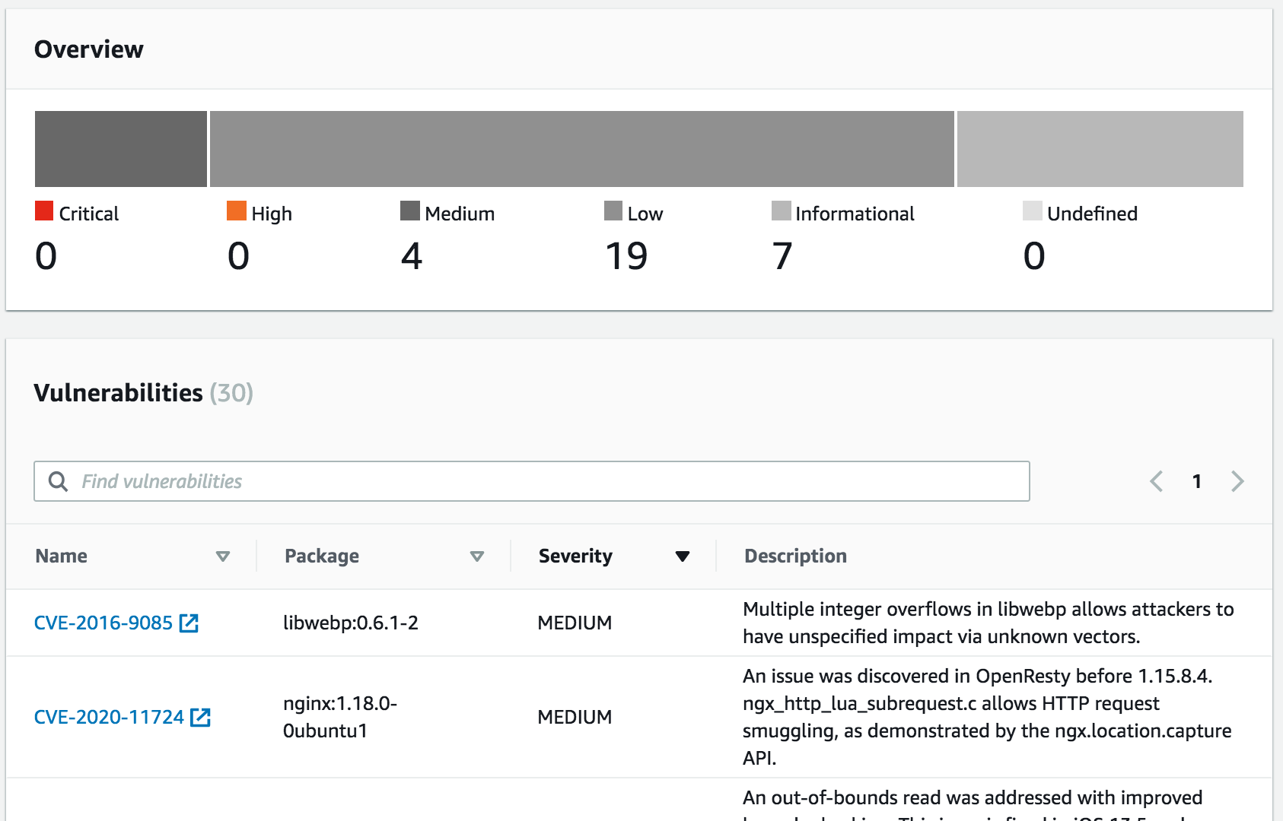

Container Images: Image scanning
https://205094881157.dkr.ecr.us-west-2.amazonaws.com
Amazon ECR
team-a/web-app
My app
image
Amazon EventBridge
Notes:
SAY: Amazon ECR image scanning helps in identifying software vulnerabilities in your container images. Amazon ECR uses the Common Vulnerabilities and Exposures (CVEs) database from the open source Clair project and provides you with a list of scan findings
SAY: You can manually scan container images stored in Amazon ECR, or you can configure your repositories to scan images when you push them to a repository.
SAY: Amazon ECR sends an event to Amazon EventBridge (formerly called CloudWatch Events) when an image scan is completed. From there, you can drive workflows and automations such as deploying or sending notifications.

Slide 20
Security in Amazon Elastic Container Registry
https://205094881157.dkr.ecr.us-west-2.amazonaws.com
{
"Version": "2012-10-17",
"Statement": [
{
"Effect": "Allow",
"Action": [
"ecr:GetAuthorizationToken",
"ecr:BatchCheckLayerAvailability",
"ecr:GetDownloadUrlForLayer",
"ecr:GetRepositoryPolicy",
"ecr:DescribeRepositories",
"ecr:ListImages",
"ecr:DescribeImages",
"ecr:BatchGetImage",
"ecr:GetLifecyclePolicy",
"ecr:GetLifecyclePolicyPreview",
"ecr:ListTagsForResource",
"ecr:DescribeImageScanFindings"
],
"Resource": "*"
}
]
}
Amazon ECR
team-a/web-app
Team B
Notes:
SAY: Identity and Access Management (IAM) administrators control who can be authenticated (signed in) and authorized (have permissions) to use Amazon ECR resources.
SAY: IAM is an AWS service that you can use with no additional charge.
SAY: In this example we’re using an Amazon ECR Identity-Based policy to grant the members of team B rights to read the images in the team-a/web-app repository. This policy would be attached to the team B members directly, or via a role / group.

Slide 21
Security in Amazon Elastic Container Registry
https://205094881157.dkr.ecr.us-west-2.amazonaws.com
{
"Version": "2008-10-17",
"Statement": [
{
"Sid": "AllowPushPull",
"Effect": "Allow",
"Principal": {
"AWS": [
"arn:aws:iam::account-id:user/push-pull-user-1",
"arn:aws:iam::account-id:user/push-pull-user-2"
]
},
"Action": [
"ecr:GetDownloadUrlForLayer",
"ecr:BatchGetImage",
"ecr:BatchCheckLayerAvailability",
"ecr:PutImage",
"ecr:InitiateLayerUpload",
"ecr:UploadLayerPart",
"ecr:CompleteLayerUpload"
]
}
]
}
Amazon ECR
team-b/web-app
Another AWS Account
Team C
Notes:
SAY: In this example we’re using Amazon ECR Resource-based policies to, for example, grant usage permission to other accounts on a per-resource basis. You can also use a resource-based policy to allow an AWS service to access your Amazon ECR repositories.

Slide 22
Amazon EKS
Amazon Elastic Kubernetes Services

Slide 23
Amazon Elastic Kubernetes Service (EKS) is a fully managed Kubernetes service. EKS runs upstream Kubernetes and is certified Kubernetes conformant.

Slide 24

Open flexibility
GitLab, Jenkins
Team
GitHub
Jenkins
Flux
DockerHub/ ECR Public [new!)
Prometheus, Grafana
[New AWS managed options for both]
ALB, NLB, NGINX, Traefik
User
Application
Istio, LinkerD, AWS App Mesh
AWS Controllers for Kubernetes (ACK)
EKS
Terraform
Fargate
EC2
Notes:
We recognize that you might not be starting from scratch when you build on AWS container services. You may have chosen Kubernetes as the core of and have existing tooling. EKS give you the ability to bring the services you want and build in a flexible environment.
Of course, if you want to use EKS with all of the AWS services, you can do that too, and we continue to prioritize Kubernetes-friendly integrations with innovations like ACK (AWS controllers for Kubernetes).
SPEAKERS NOTE: Go into as much depth as you think appropriate on this slide

Slide 25
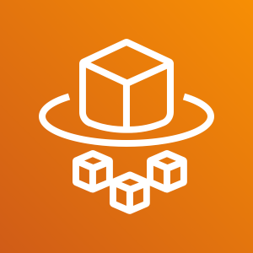




Run your containers anywhere based on your workload needs
Serverless
EC2 options
Edge and 5G
On-premises
AWS Fargate
Amazon EC2
AWS Local Zones
AWS Wavelength
AWS Outposts
EKS Anywhere
ECS Anywhere
Spot instance
Notes:
Amazon ECS and Amazon EKS manage how your containers run, but you still need a compute layer. AWS gives you a range of integrated compute options for where that happens. You can choose the right tool for the job to get the right blend of cost, performance, and features.
On both Amazon EKS and Amazon ECS, you have the option of running your containers on the following compute options:
AWS Fargate — a “serverless” container compute engine where you only pay for the resources required to run your containers. Suited for customers who do not want to worry about managing servers, handling capacity planning, or figuring out how to isolate container workloads for security.
EC2 instances — offers widest choice of instance type including processor, storage, and networking. Ideal for customers who want to manage or customize the underlying compute environment and host operating system.
AWS Outposts— run your containers using AWS infrastructure on premises for a consistent hybrid experience. Suited for customers who require local data processing, data residency, and hybrid use cases.
AWS Local Zones — an extension of an AWS Region. Suited for customers who need the ability to place resources in multiple locations closer to end users.
AWS Wavelength— ultra-low-latency mobile edge computing. Suited for 5G applications, interactive and immersive experiences, and connected vehicles.
And coming soon, you can run both ECS and EKS on your own managed infrastructure with ECS Anywhere, EKS Anywhere and EKS Distro

Slide 26

Kubernetes Concepts
Node
Docker
Pod
Containers
Pods: Co-located group of containers that share an IP, namespace, storage volume
ReplicaSet
#Pods—2
label selector: v1
ReplicaSet
#Pods—1
label selector: v2
Replica Set: Manages the lifecycle of pods and ensures specified number are running
Pod
Pod
Pod
v1
v1
v2
“web”
Service: Single, stable name for a set of pods, also acts as LB
Label: Used to organize and select group of objects
port 8080
port 8080
Notes:
For those of you not too familiar with Kubernetes, let’s start with a quick overview of some core concepts.
Pods - Co-located group of containers that share an IP, namespace, storage volume
Replica Sets - Manages the lifecycle of pods and ensures specified number are running
Services - Single, stable name for a set of pods, also acts as LB
Labels - Used to organize and select group of objects

Slide 27
Kubernetes Concepts
Namespaces: “Virtual” clusters for users/projects
Ingress controller: L7 load balancing
Deployments: Declarative version updates
Jobs: Run to completion
Autoscale: Automatically adjust number of Pods
Network Policies: AKA Security Groups for Pods
StatefulSet: Support for long-term stateful distributed systems
More…

Slide 28
Kubernetes with EKS vs running on EC2?
We deploy the Kubernetes Control Plane and etcd in a highly-available configuration across 3 AZs
We manage that control plane for you in a similar way to our managed relational database service RDS
We provide a network (CNI) plugin that integrates Pod networking natively with AWS VPC
We integrate/federate user access to the Kubernetes CLI (kubectl) and API with AWS IAM
Notes:
You can run Kubernetes yourself via virtual machines on our EC2 so what does EKS do for you over doing it yourself?
(CLICK)
We deploy the Kubernetes Control Plane and etcd in a highly-available configuration across 3 AZs
etcd is a distributed reliable key-value store for the most critical data of a distributed system, with a focus on being:
(CLICK)
And we manage that control plane for you in a similar way to our managed relational database service RDS
(CLICK)
We provide, and actually require that you use, a network (CNI) plugin we’ve opensourced that integrates Pod networking natively with AWS VPC
(CLICK)
And we integrate/federate user access to the Kubernetes CLI (kubectl) and API with AWS IAM via our aws-iam-authenticator plugin

Slide 29

EKS is Kubernetes Certified
EKS runs upstream Kubernetes and is certified as Kubernetes conformant.
This means that applications managed by Amazon EKS are fully compatible with applications managed by any standard Kubernetes environment.
Notes:
Things to mention:
Amazon EKS runs upstream Kubernetes and is certified Kubernetes conformant,
Applications managed by Amazon EKS are fully compatible with applications managed by any standard Kubernetes environment.

Slide 30

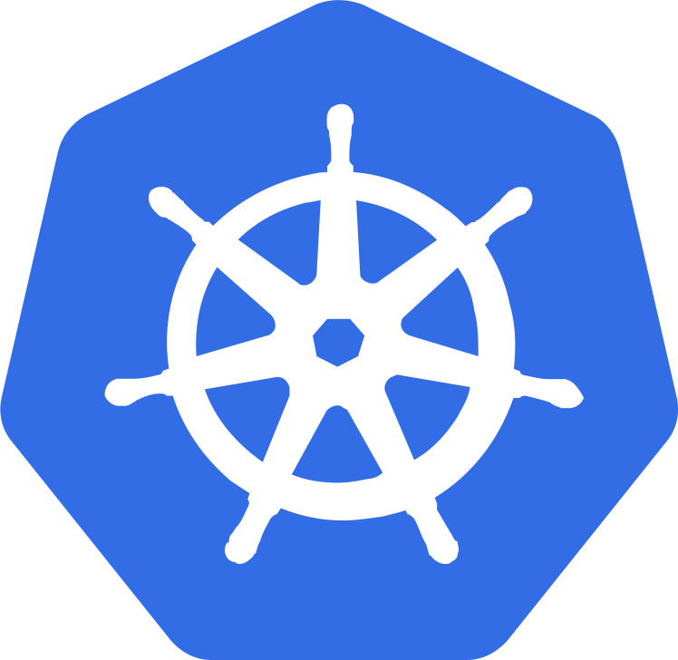




Containers options on AWS – over time
AWS Cloud
K8s API
Worker nodes
EC2 Container Instances
2019
Customer managed
Docker
Host
Managed
Node Groups
DIY K8S
Auto Scaling group
Auto Scaling group
Auto Scaling group
K8s API
ECS API
Amazon EKS
Amazon ECS
AWS managed
AWS Fargate

Slide 31
Containers options on AWS – over time
AWS Cloud
K8s API
Worker nodes
EC2 Container Instances
Customer managed
Docker
Host
Managed
Node Groups
DIY K8S
Auto Scaling group
Auto Scaling group
Auto Scaling group
K8s API
ECS API
Amazon EKS
Amazon ECS
AWS managed
NEW
AWS Fargate

Slide 32

EKS data plane options Worker nodes only
Pods
Amazon EKS
Availability Zone 1
Availability Zone 2
Amazon EC2 Auto Scaling
Auto Scaling group
Worker node
Worker node
Auto Scaling group
Worker node
Worker node
Traditional container data plane

Slide 33
EKS data plane options Mixed mode
Pods
Pods
Amazon EKS
NEW
Availability Zone 1
Availability Zone 2
Amazon EC2 Auto Scaling
Auto Scaling group
AWS Fargate
Worker node
Worker node
Auto Scaling group
Worker node
Worker node
Serverless container data plane
Traditional container data plane

Slide 34
EKS data plane options Fargate only
Pods
Amazon EKS
NEW
AWS Fargate
Serverless container data plane

Slide 35
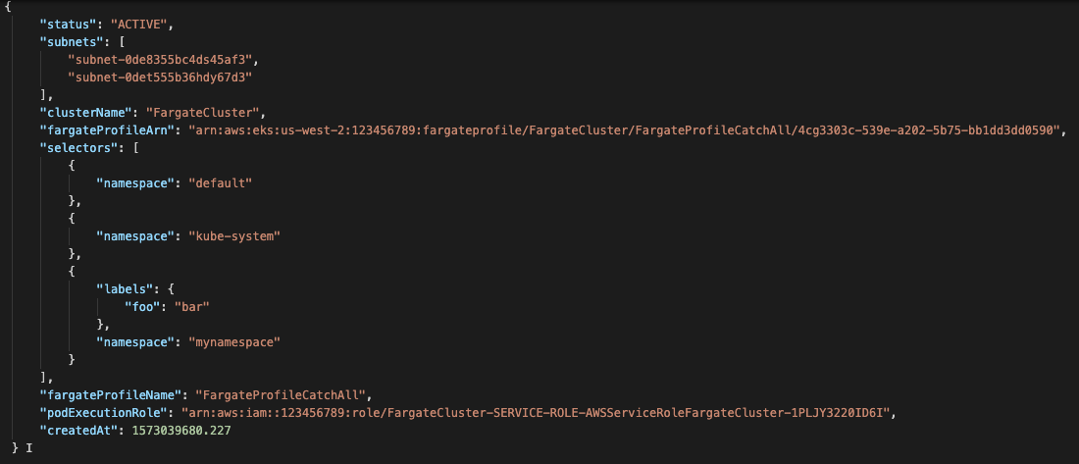
Fargate profile template
Subnets to pick for the Pod deployment
Parameters to “catch” the pod deployment
IAM Role to be associated to the kubelet

Slide 36
Simplified deployment flow
1
2
namespace: test
Mutating/ Validating Webhooks
Pod
Fargate profile
Fargate Scheduler
3
{
"name": profile-a,
"clusterName": mycluster,
"podExecutionRole": iam-role-xyz,
"subnets": subnet-0ad888345,
"selectors": [
{
"namespace": prod,
"labels": {
stack: blue
}
}
]
}
Amazon EKS
Kubernetes
Pod
4
Availability Zone 1
Availability Zone 2
Amazon EC2 Auto Scaling
Auto Scaling group
AWS Fargate
Worker node
Worker node
Auto Scaling group
Worker node
Worker node

Slide 37
Simplified deployment flow
1
2
namespace: prod
labels: - stack: blue
Mutating/ Validating Webhooks
3
Pod
Fargate profile
Fargate Scheduler
namespace: prod
labels: - stack: blue
profile = profile-a
schedulerName = fargate-scheduler
{
"name": profile-a,
"clusterName": mycluster,
"podExecutionRole": iam-role-xyz,
"subnets": subnet-0ad888345,
"selectors": [
{
"namespace": prod,
"labels": {
stack: blue
}
}
]
}
Pod
Amazon EKS
Kubernetes
Pod
4
Availability Zone 1
Availability Zone 2
Amazon EC2 Auto Scaling
Auto Scaling group
AWS Fargate
Worker node
Worker node
Auto Scaling group
Worker node
Worker node

Slide 38
Amazon ECS
Amazon Elastic Container Service

Slide 39
Powerful simplicity
CodePipeline
Dev
CodeCommit
CodeBuild
CodeDeploy
ECR
CloudWatch
ALB
User
Application
App Mesh
ECS
CloudFormation
Fargate
EC2
Copilot
Notes:
Designed for simplicity from the start, using Amazon ECS decreases the number of decisions customers must make around compute, network, and security configurations. For example, if you need a load balancer, AWS Application Load Balancer (ALB) or Network Load Balancer (NLB) integrate seamlessly with Amazon ECS, so you don’t need to build or maintain generalized abstractions.
ECS is is very friendly and familiar to developers with experience using Docker.
ECS is a great starting point if you want to move quickly.
Recently released ECS Copilot - a new CLI to deploy and operate containers in AWS

Slide 40


Scheduling and Orchestration
ECS
Cluster Manager
Placement Engine
Notes:
SAY: Scheduling and orchestration are key components of ECS and the cluster manager and the placement engine play specific roles to help accomplish these.
SAY: Cluster manager manages health of the instances within your cluster. You set up an auto scaling group and register your instances with your cluster. ECS is then aware of the capacity you desire for your containers.
SAY: Placement engines on the other hand enables much advanced techniques for how you want to place your tasks onto the EC2 instance. For e.g. if you have certain tasks that you want to land on certain instance types or if you desire super-efficient bin-packing for better economics, the placement engine enables you to do that.

Slide 41
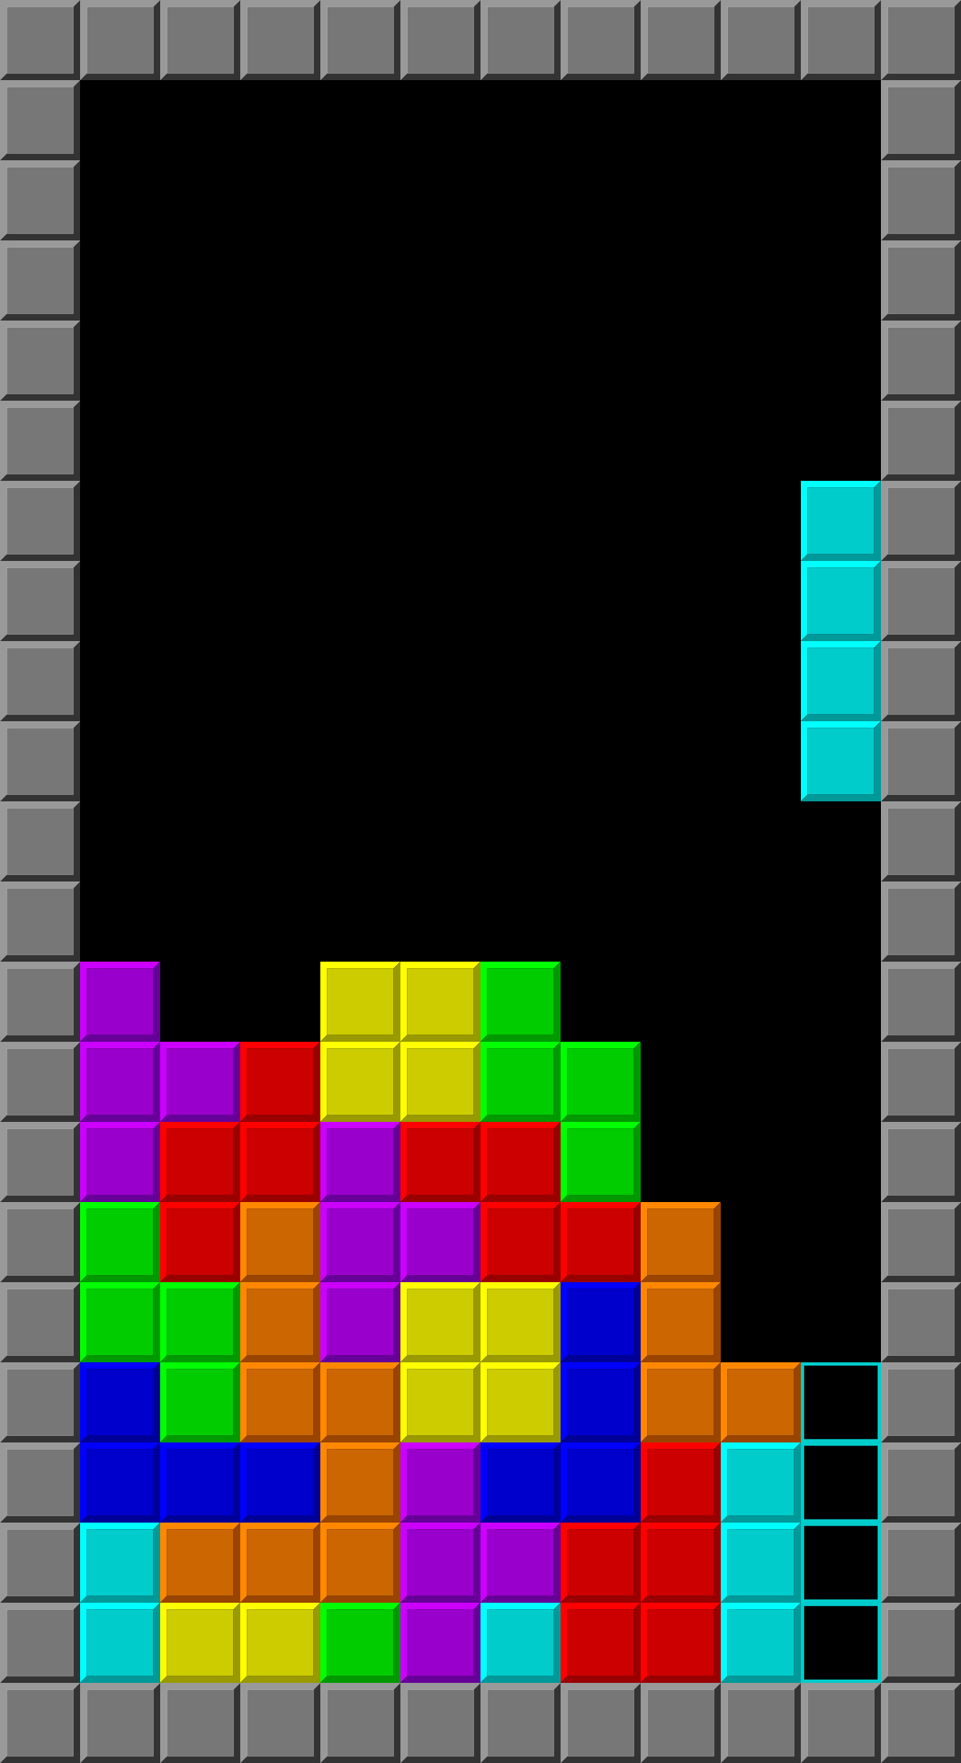
Notes:
SAY: This is how I like to think about scheduling … The objective of the game of Tetris is to use the pieces – which are tiles that come in a number of geometric forms - to create as many horizontal lines of blocks as possible. Or, in other words, make them fit in the most efficient way possible. Sound familiar?

Slide 42
Amazon ECS constructs
Cluster
Resource grouping and isolation
IAM permissions boundary
Capacity providers
Notes:
SAY: Let’s start with the CLUSTER: An Amazon ECS cluster is a logical grouping of tasks or services. If you are running tasks or services that use the EC2 launch type, a cluster is also a grouping of container instances. If you are using capacity providers, a cluster is also a logical grouping of capacity providers. When you first use Amazon ECS, a default cluster is created for you, but you can create multiple clusters in an account to keep your resources separate.
ECS capacity provider A capacity provider is associated with a cluster and is used in a capacity provider strategy to determine the infrastructure that a task runs on.
For Amazon ECS on AWS Fargate users, there is a FARGATE and a FARGATE_SPOT capacity provider.
For Amazon ECS on Amazon EC2 users, a capacity provider consists of a capacity provider name, an Auto Scaling group, and the settings for managed scaling and managed termination protection
A default capacity provider strategy is associated with an Amazon ECS cluster. This determines the capacity provider strategy used creating a service or running a standalone task in the cluster when there isn't a custom capacity provider strategy or launch type specified. It is considered best practice to define a default capacity provider strategy for each cluster.

Slide 43

Amazon ECS constructs
Cluster
Resource grouping and isolation
IAM permissions boundary
Capacity providers
Container Instance
Notes:
SAY: Next we have CONTAINER INSTANCES: An Amazon ECS container instance is an Amazon EC2 instance that is running the Amazon ECS container agent and has been registered into an Amazon ECS cluster. When you run tasks with Amazon ECS using the EC2 launch type or an Auto Scaling group capacity provider, your tasks are placed on your active container instances.

Slide 44

Amazon ECS constructs
Cluster
Resource grouping and isolation
IAM permissions boundary
Capacity providers
{ ; }
JSON
Container Instance
Task definition
Template used by Amazon ECS to launch tasks
Parallels to docker run parameters
Defines requirements:
CPU/Memory
Container image(s)
Logging
IAM role
Etc.
Container 1
Container 1
Task
Running instance of a task definition
One or more containers
Notes:
SAY: Then there are TASKS AND TASK DEFINITIONS: A task is an instantiation of a task definition that is running on a container instance or in AWS Fargate. A Task Definition is the the blueprint for your task. Specifies the name of the task, revisions, container definitions, and volume information.

Slide 45

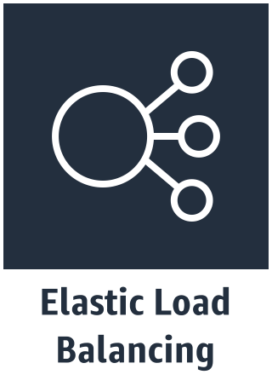
Amazon ECS constructs
Cluster
Resource grouping and isolation
IAM permissions boundary
Capacity providers
{ ; }
JSON
Container Instance
Task definition
Template used by Amazon ECS to launch tasks
Parallels to docker run parameters
Defines requirements:
CPU/Memory
Container image(s)
Logging
IAM role
Etc.
Container 1
Container 1
Container 1
Container 1
Task
Running instance of a task definition
One or more containers
Service
Maintains desired # of running tasks
Replaces unhealthy tasks
ELB integration
Container 1
Notes:
SAY: Let’s start with the CLUSTER: An Amazon ECS cluster is a logical grouping of tasks or services. If you are running tasks or services that use the EC2 launch type, a cluster is also a grouping of container instances. If you are using capacity providers, a cluster is also a logical grouping of capacity providers. When you first use Amazon ECS, a default cluster is created for you, but you can create multiple clusters in an account to keep your resources separate.
SAY: Next we have CONTAINER INSTANCES: An Amazon ECS container instance is an Amazon EC2 instance that is running the Amazon ECS container agent and has been registered into an Amazon ECS cluster. When you run tasks with Amazon ECS using the EC2 launch type or an Auto Scaling group capacity provider, your tasks are placed on your active container instances.
SAY: Then there are TASKS AND TASK DEFINITIONS: A task is an instantiation of a task definition that is running on a container instance or in AWS Fargate. A Task Definition is the the blueprint for your task. Specifies the name of the task, revisions, container definitions, and volume information.
SAY: Finally, we have SERVICES: An Amazon ECS service enables you to run and maintain a specified number of instances of a task definition simultaneously in an Amazon ECS cluster. If any of your tasks should fail or stop for any reason, the Amazon ECS service scheduler launches another instance of your task definition to replace it in order to maintain the desired number of tasks in the service.

Slide 46
Task definition
{
"containerDefinitions": [
{
"memory": 128,
"portMappings": [
{
"hostPort": 80,
"containerPort": 80,
"protocol": "tcp"
}
],
"essential": true,
"name": "nginx-container",
"image": "nginx",
"logConfiguration": {
"logDriver": "awslogs",
"options": {
"awslogs-group": "ecs-log-streaming",
"awslogs-region": "us-west-2",
"awslogs-stream-prefix": "fargate-task-1"
}
},
continued…
"cpu": 0
}
],
"networkMode": "awsvpc",
"executionRoleArn": "arn:aws:iam::123456789012:role/ecsTaskExecutionRole",
"memory": "2048",
"cpu": "1024",
"requiresCompatibilities": [
"FARGATE"
],
"family": "example_task_1"
}
Notes:
SAY: A task definition is and immutable, versioned document, Identified by family:version. Task definitions can contain a list of up to 10 container definitions.
SAY: All containers defined with a task definition are co-located (co-scheduled) on the same host.
SAY: Each container definition has A name, Image URL (ECR or Public Images) and more…stay tuned

Slide 47
Deploying on ECS: Tasks vs Services
On-Demand Workloads
ECS task scheduler
Run once or at intervals
Batch jobs
RunTask API
StartTask (custom)
Long-Running Apps
ECS service scheduler
Health management
Scale-up and scale-down
AZ aware
Grouped containers
Notes:
SAY: We’ve talked about Tasks and Services and we’ve explained some of the differences between them, but which one do you use for your particular workload?
SAY: For on-demand workloads, the ECS task scheduler is the best option. It is ideal for workloads that need to run once, or at recurring intervals. Things like batch or short-lived operations. This task scheduler kicks in when the RunTask API is invoked.
SAY: For long running workloads, the ECS service scheduler is used. It provides health management features, to ensure workloads are up and responding correctly. The ECS service scheduler also supports the scaling up and down of workloads and has an awareness of availability zones. These features make it ideal of workloads that need to be highly available and scale to meet changes in demand.

Slide 48
Task placement
Cluster Constraints
Satisfy CPU, memory, and networking requirements
Custom Constraints
Filter for location, instance-type, AMI, or other custom attribute constraints
Placement Strategies
Identify instances that meet spread or binpack placement strategy
Apply Filter
Select final container instances for placement
Notes:
SAY: Let’s look at a scenario where you had 10 container instances. To start you’ll make a request to run some tasks or create a service. As part of that request you’ll specify CPU, memory, or port requirements.
SAY: In addition now, you’ll also provide other constraints, such as specific Availability Zone, AMI or instance-type.
SAY: And then last you’ll tell us the strategy you prefer for us to use when starting the tasks, which could range from spread for availability, binpack to optimize for utilization, place together (affinity) or place apart (anti-affinity), etc.
SAY: At the end of that process we have identified a set of instances that satisfies the requirements for the task you want to run and we place (or run) those tasks across your cluster based on the requirements specified.

Slide 49
AWS Fargate
Notes:
SAY: As customers were adopting ECS to manage complex containerized application, we realized that they still ended up managing more than just containers. There are these additional layers of management they need to manage when all they wanted to do was run containers!
SAY: To overcome this challenge, we launched AWS Fargate which is a serverless way to run containers.
SAY: Both ECS and EKS (Elastic Kubernetes Service) support running containerised workloads using AWS Fargate. We will explore Fargate for EKS in a later module, for the moment, we will be looking at it from a ECS perspective.

Slide 50


Without Fargate – you manage more than just containers
EC2 Instance
OS
Container Rungime
ECS Agent
Notes:
SAY: Let’s look at an example to better understand how Fargate helps you run serverless containers. Without Fargate, you’ve an EC2 instance with 2 tasks running on it .
SAY: A task is a collection of containers that run together as a unit of your application. So here to support the 2 tasks you have to manage the underlying instance such the instance OS, the container runtime, as well as, in the case of Amazon ECS, the ECS Agent. This is still quite a bit of operational overhead.

Slide 51
- Patching and Upgrading OS, agents, etc.
- Scaling the instance fleet for optimal utilization
Notes:
SAY: So you end up having to to patch and update the OS, ECS agent etc while also scaling the instance fleet for optimal utilization.
SAY: All of these tasks are still required which add layers of management to your application.

Slide 52
Amazon Elastic Container Service
Notes:
SAY: And this is what your layers of management end up looking like. You’ve this completely managed orchestration or container management layer but you also have these software management layers just to run your application.

Slide 53
Amazon Elastic Container Service
AWS Fargate
run serverless containers
Notes:
SAY: And all you really want here is to run your containers. And Fargate enables you to do just that in a serverless manner. So if you notice here, there are no 2 levels of management of scale anymore. You only define the requirement of your application in terms of a task – how should the service scale, what metrics do you care about and how many more such container or task you want Fargate to launch.
SAY: At this point, you might be asking yourself how do I ensure that my tasks are running on the latest and greatest managed components? What if, for example, I want to use a feature that is only supported in newer versions of the Amazon ECS container agent?
SAY: Great question … <CLICK>

Slide 54
AWS Fargate platform versions
Amazon Elastic Container Service
AWS Fargate
Platform version 1.4.0
Notes:
SAY: Which brings us to AWS Fargate Platform Versions.
SAY: AWS Fargate platform versions are used to refer to a specific runtime environment for Fargate task infrastructure. It is a combination of the kernel and container runtime versions.
SAY: New platform versions are released as the runtime environment evolves, for example, if there are kernel or operating system updates, new features, bug fixes, or security updates
SAY: Security updates and patches are deployed automatically for your Fargate tasks
SAY: If a security issue is found that affects a platform version, AWS patches the platform version

Slide 55
AWS Fargate
Managed by AWS
No EC2 Instances to provision, scale or manage
Elastic
Scale up & down seamlessly. Pay only for what you use
Your containerized applications
Integrated
With the AWS ecosystem: VPC Networking, Elastic Load Balancing, IAM Permissions, CloudWatch and more
Notes:
SAY: Let’s quickly re-cap on Fargate ….
We launched Fargate in November 2017
With the primary goal of completely managed infrastructure.
You don’t have to worry about patching or upgrading or how do I pick the right instance type or instance size
and its fully integrated with the AWS ecosystem.
SAY: We have over the years invested in making the container the first level primitive of the AWS platform which means when it comes to IAM resources or networking or load balancers or integration with VPC, it is all built into ECS and Fargate takes advantage of that.

Slide 56
Fully managed container environment with AWS ECS + Fargate
Bring existing code
Production ready
Powerful integrations
No changes required of existing code, works with existing workflows and microservices built on Amazon ECS
ISO, PCI, HIPAA, SOC compliant. Launch ten or tens of thousands of containers in seconds in 9 global regions (+7 in 2018)
Native AWS integrations for networking, security, CICD, monitoring, and tracing
Fargate runs tens of millions of containers for AWS customers every week
Notes:
Customers that want fully managed services that abstract the underlying infrastructure include teams at the largest enterprises and smaller companies that are born in the cloud.They see their ability to develop and deliver new technology products as a critical differentiator and want fully managed services that enable them to build without requiring them to build things themselves and investing in hiring or training staff that have infrastructure management skills.
Fargate works with Amazon ECS so you can bring your existing code and applications and run them.
Fargate is HIPAA eligible and ISO, PCI, and SOC compliant so you can run critical production applications.

Slide 57
Amazon ECS and EKS

Slide 58
Amazon EKS or Amazon ECS?
ECS
EKS
Powerful simplicity
Open flexibility
AWS-opinionated way to run containers at scale
Reduce decisions without sacrificing scale or features
Reduce time to build, deploy, and migrate applications
Great for both short and long running tasks/services
Gain agility and efficiency with AWS-optimized Kubernetes, and standardize operations everywhere
Secure, highly available, with observability across all Kubernetes deployments
Build with choice of solutions from the broader community around Kubernetes
Great for long running tasks/services, large scale enterprise applications
Notes:
The choice of orchestrator is important, as this is the key integration point for it will deeply influence the rest of the choices you make
One of the most common requests we hear from customers is, “help me decide which container service to use.”
We recommend that most teams begin by selecting a container solution with the attributes most aligned to their application requirements or operational preferences.
AWS customers have a choice of fully managed container services, including Amazon Elastic Container Service (Amazon ECS) and Amazon Elastic Kubernetes Service (Amazon EKS).
Both services support a broad array of compute options, have deep integration with other AWS services, and provide the global scale and reliability you’ve come to expect from AWS. So how are they different?

Slide 59
AWS Batch
Fully managed batch service running on top of Amazon ECS

Slide 60
What is AWS Batch?
Job Scheduler
Orchestrator
Notes:
In 2017 we announced the launch of AWS Batch, its purpose back then, and now, is to streamline running simple batch workloads in the cloud.
Job Scheduler: AWS Batch controls and manages job lifecycle for millions of jobs, from dependency and retry management to state monitoring.
Orchestrator:
AWS Batch offers fully managed batch computing primitives.
We allow you to run your applications that are either explicitly or implicitly containerized. So you can give us a docker command, a docker container image, and the parameters with which you like us to run that docker image. Or you can give us a zip that you’d like us to run on top of the default Amazon Linux container image and we’ll take care of the rest for you.
Evaluates when, where, and how to run jobs that have been submitted to a job queue.
It provision and scale the compute instances that is needed for each job que and then shut them down when the job is completed.
It manages job ques and workflow from start to finish, with each job/que requiring a different mix of hardware resources.

Slide 61

Why AWS Batch?
Integrated with
AWS Services
Optimized
Resource Provisioning
Fully Managed
Cost Efficient
Notes:
AWS Batch has been constantly evolving to give you the ability to choose a solution that works best for your workload.
We’re going to talk about AWS Batch, and how it helps you launch, customize, and scale your workload, taking advantage of the breadth and depth of resources, yet managing them for you so you can focus on your applications.
Reduce the need for compute resource management:
Set of Fully-managed batch primitives - handle the scaling of appropriate instances and the scheduling of those jobs on the instances.
Batch will provision appropriate resources for your jobs. taking advantage of the spot market if that is appropriate.
Avoid the complexities of provisioning, managing, monitoring, and scaling batch computing jobs.
AWS Batch maintains job, dependency, and retry lifecycle, as well as compute resource lifecycle.
Focus on analyzing results and solving problems.
Seamless AWS Services integration:
Cloud native orchestrator.
Integrates seamlessly with other AWS services (Lambda, Step Function, DynamoDB, S3. Spot)
It schedules and executes batch computing workloads across the full range of AWS compute services.
Customers had been plugging together some 20+ different services to get a batch workload processed.
Optimize resource provisioning:
Dynamically provisions the optimal quantity and type of compute resources (S3, CPU, GPU or memory optimized instances) based on the volume and specific resource requirements of the batch jobs submitted.
It improves job execution efficiency and scales up and down based on the need of the jobs submitted.
Look for deepest Spot instances pool and assign it to the CE.
Lower Cost:
AWS Batch is free.
Only pay for the AWS resources (EC2 instances, S3, DynamoDB) you use.
Go from Cap-Ex to Op-EX
AWS Batch takes advantage of different EC2 and Spot instances to reduce overall job execution cost.
No Undifferentiated Heavy Lifting - Focus on your applications (shell scripts, Linux executables, container images) and their resource requirements
We take care of the rest!

Slide 62
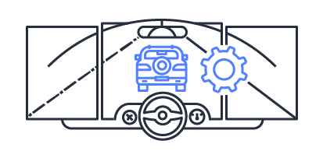


Who uses AWS Batch?
Autonomous vehicle ML and simulation
Gene sequencing
& Drug Discovery
Big data
Machine Learning
Financial risk analysis
Renewable Energy,
Oil and gas exploration
Weather simulation
EDA, CAD, FDC
Notes:
AWS Batch is used by a large number of segments, from autonomous vehicles and ML to Computer-Aided Design from companies such as Western Digital, who uses AWS Batch to simulate energy-assisted recording technology. AWS Batch allows them to easily shrink simulation time from 20 days to 8 hours, dramatically improving time to results.
Matterport uses AWS Batch to process tens of thousands of 3D models a day for their customers, and bringing down the creation time for their containerized application environment from more than a year to a few months.
Life-science research with QBiC. They use AWS Batch to analyze genomics data and determine, for example, gene expression differences between diseased and normal tissue. The automation and orchestration provided by AWS Batch potentially cuts research time by 50 percent
You all continue to surprise us with new and innovative uses of batch and many of the new features additions you see in the service today are a direct result of those.

Slide 63
AWS Batch Key Concepts
Job Definitions
Job States
Job Queue
Scheduler
Compute Environments
Allocation Strategies
Jobs: Single jobs vs array jobs
Notes:
Let’s start with job queues (20 Max):
In AWS Batch, jobs are submitted to an AWS batch job queue within your account. You can have multiple job queues and each of these job queues can have a relative priority to each other. Your jobs can reside in these job queues until they are ready to run either because those jobs have an external dependency on another job or because we are waiting for resources to be launched for those jobs to run upon.
The job queues that you created are mapped to one or more compute environments (CEs).
Compute Environment: You can think of a compute environment as a pool of resources/instances, that your jobs use. There are two types of compute environments: managed compute environments and unmanaged compute environments.
For managed compute environments, you are giving Batch some guardrails. You are telling AWS Batch the min and max and desired number of vCPUs in aggregate. You are also telling AWS Batch which instance types you would like AWS Batch to launch on your behalf. You can be either very prescriptive and say only launch C4.8xl instances, or select “optimal” and let Batch figure out the best instance type and size for you, base on your job size and cost. If you want to use Spot Instances, in your CE, you have the option to tell AWS Batch what percentage of on-demand pricing you would like AWS Batch to set as a cap to control your cost, meaning if the current Spot price is at 30% of on-demand price, you have the option to set say 50% as the cap. If Spot market price exceeds 50% of on-demand price, we will terminate these instances for you to control cost.
After you have provided these guardrails, we will start to launch compute resources in response to the arrival of jobs and the resource requirements of those jobs. For example If you have a lot of memory intensive jobs we'll start launching instances that have appropriate amounts of memory for these workloads. If you have CPU intensive workloads that don't need as much memory, we can we can run those on compute resources that are more appropriately sized for those jobs. And because we’re running your jobs within Docker containers, we have the ability to write multiple jobs concurrently on the same host and so we get more efficiency gains in the execution of those those jobs on top of your ec2 instances. The instances that we launched are launched within your AWS account, so you'll see these popping up in the ec2 console and you have the ability to to interact with them if you like.
For example, if you create a managed CE and set 0 as your min vCPU, 2 as your desired vCPU, and 128 as the max vCPU, Batch will scale up 2 vCPU worth of instance (depending on the instance type you selected) at first regardless of whether you have any job in the queue, then we will scan the queue every 10 minutes to see how many jobs are there, if we see lots of jobs, we will scale up more instances up to the max number of vCPUs set by you. If we don’t see any jobs in the queue, we will scale down to the min number of vCPUs set by you. In this case, we will kill all instances because your min vCPU is 0. When you submit more jobs later, we will scale up again.
Next, job definitions. You can think of a job definition as a template for the job or jobs that you’d like to run. The job definition tells us the application you’d like to run, the role that you’d like to associate with the job when it executes, the mount points so Batch knows how you’d like to map that within the container instance when we actually execute the job, as well as environmental variables and other properties of the container. Some users create a job definition per job. Other users use a job definition as a template for a common job type. Users also have an option to override one or multiple parameters at job submission.
4. Let’s talk about jobs. Jobs are the unit of work executed by AWS Batch. A job is a container image, command, and parameters. When you submit a job, you have to specify the job name, the job definition, and the job queue. You will also have the option to override some parameters from the job definition. Jobs are the unit of work executed by AWS Batch as containerized applications running on Amazon EC2.
Containerized jobs can reference a container image, command, and parameters or users can simply provide a .zip containing their application and we will run it on a default Amazon Linux container.
There are 7 jobs states. Once you submit a job, it is accepted into the queue and is at the “submitted” state. Jobs submitted to a queue can have the following states:
SUBMITTED: Accepted into the queue, but not yet evaluated for execution
PENDING: Your job has dependencies on other jobs which have not yet completed
RUNNABLE: Your job has been evaluated by the scheduler and is ready to run
STARTING: Your job is in the process of being scheduled to a compute resource
RUNNING: Your job is currently running
SUCCEEDED: Your job has finished with exit code 0
FAILED: Your job finished with a non-zero exit code or was cancelled or terminated.
If you have lots of jobs, say millions, it is not viable to submit 1 job at a time. Instead of submitting a large number of independent “single jobs”, Batch also supports a feature called “array jobs” where you can give us the command you'd like to run and say run a thousand copies of this and here's the array of parameters for all of those jobs that were running and then each job can do effectively the same thing but each working on their part of the of the bigger puzzle. Array jobs are great for parametric sweeps and Monte Carlo simulations.
5. Last Batch concept is the scheduler. It runs behind the scene, making sure that those jobs run in the right order on appropriately sized resources. The scheduler is also responsible for ensuring that we scale up and down appropriately with the the right heterogeneous mix of compute resources.
AWS Batch currently uses a FIFO (first in first out) scheduling algorithm. Jobs run in approximately the order in which they are submitted as long as all the dependencies have been met. Over time, we plan to add more types of scheduling algorithms such as fair share scheduling and deadline scheduling.

Slide 64
Job Definitions
AWS Batch job definitions specify how jobs are to be run.
Some attributes in a job definition:
Container Image
IAM role associated with the job
vCPU and memory requirements
Mount points
Environment variables
Retry strategy
While each job must reference a job definition, many parameters can be overridden
Notes:
Job definitions. You can think of a job definition as a template for the job or jobs that you’d like to run. The job definition tells us the application you’d like to run, the role that you’d like to associate with the job when it executes, the mount points so Batch knows how you’d like to map that within the container instance when we actually execute the job, as well as environmental variables and other properties of the container. Some users create a job definition per job. Other users use a job definition as a template for a common job type. Users also have an option to override one or multiple parameters at job submission.
A job definition specifies how jobs are to be run; you can think of it as a blueprint for the resources in your job. You can supply your job with an IAM role to provide programmatic access to other AWS resources, and you specify both memory and CPU requirements.
The job definition can also control container properties, environment variables, and mount points for persistent storage.
Many of the specifications in a job definition can be overridden by specifying new values when submitting individual Jobs.
Some of the attributes specified in a job definition include:
• Which Docker image to use with the container in your job
• How many vCPUs and how much memory to use with the container
• The command the container should run when it is started
• What (if any) environment variables should be passed to the container when it starts
• Any data volumes that should be used with the container
• What (if any) IAM role your job should use for AWS permissions
Your AWS Batch compute environments and container instances require AWS account credentials to make calls to other AWS APIs on your behalf. You must create an IAM role that provides these credentials to your compute environments and container instances, then associate that role with your compute environments.
The AWS Batch compute environment and container instance roles are automatically created for you in the console first-run experience, so if you intend to use the AWS Batch console, you can move ahead to the next section. If you plan to use the AWS CLI instead, complete the procedures in AWS Batch Service IAM Role and Amazon ECS Instance Role before creating your first compute environment.
Retry Strategy
When you register a job definition, you can optionally specify a retry strategy to use for failed jobs that are submitted with this job definition.
By default, each job is attempted one time.
If you specify more than one attempt, the job is retried if it fails (for example, if it returns a non-zero exit code or the container instance is terminated).
the job definition and the job submission workflows allow you to specify a retry strategy with between 1 and 10 attempts. For more information
Possible failure scenarios include:
• Any non-zero exit code from a container job
• Amazon EC2 instance failure or termination
• Internal AWS service error or outage
Timeout
You can configure a timeout duration for your jobs so that if a job runs longer than that, AWS Batch
terminates the job.
If a job is terminated due to a timeout, it is not retried. Any timeout configuration that is specified during a SubmitJob operation
overrides the timeout configuration defined here

Slide 65
Job States
SUBMITTED
PENDING
RUNNABLE
STARTING
RUNNING
SUCCEEDED
FAILED
Notes:
There are 7 jobs states. Once you submit a job, it is accepted into the queue and is at the “submitted” state.
Jobs submitted to a queue can have the following states:
SUBMITTED: Accepted into the queue, but not yet evaluated by the scheduler for execution
PENDING: Your job has dependencies on other jobs which have not yet completed
RUNNABLE: Your job has been evaluated by the scheduler and is ready to run
STARTING: Your job is in the process of being scheduled to a compute resource
RUNNING: Your job is currently running
SUCCEEDED: Your job has finished with exit code 0
FAILED: Your job finished with a non-zero exit code (can be retried, if it was defined) or was cancelled or terminated (can’t be retried).
Job dependencies:
When you submit an AWS Batch job, you can specify the job IDs on which the job depends.
When you do so, the AWS Batch scheduler ensures that your job is run only after the specified dependencies have successfully completed.
After they succeed, the dependent job transitions from PENDING to RUNNABLE and then to STARTING and RUNNING.
If any of the job dependencies fail, the dependent job automatically transitions from PENDING to FAILED.
For example, Job A can express a dependency on up to 20 other jobs that must succeed before it can run.
You can then submit additional jobs that have a dependency on Job A and up to 19 other jobs.
For array jobs, you can specify a SEQUENTIAL type dependency without specifying a job ID so that each child array job completes sequentially, starting at index 0. You can also specify an N_TO_N type dependency with a job ID.
That way, each index child of this job must wait for the corresponding index child of each dependency to complete before it can begin.

Slide 66
Job Queues
Jobs are submitted to Job Queues, where they reside until they are able to be scheduled to a compute resource. Information related to completed jobs persists in the queue for 24 hours.
Job queues are assigned to one or more Compute Environments.
Each job queue has a priority assigned. Jobs in queues with higher priority take precedence.
Notes:
Job Queues link jobs to compute environments.
Multiple Job Queues can have the same environment assigned.
Job queues have a priority that is used by the scheduler to determine which jobs in which queue should be evaluated for execution first.
And job queues can also have multiple compute environments. E.g. one consists of spot instances and another of on demand instances.
You define the order of the compute environment to define which one gets the job.

Slide 67
Scheduler
The Scheduler evaluates when, where, and how to run jobs that have been submitted to a job queue.
Jobs run in approximately the order in which they are submitted as long as all dependencies on other jobs have been met.
Notes:
There are 7 jobs states. Once you submit a job, it is accepted into the queue and is at the “submitted” state.
Jobs submitted to a queue can have the following states:
SUBMITTED: Accepted into the queue, but not yet evaluated by the scheduler for execution
PENDING: Your job has dependencies on other jobs which have not yet completed
RUNNABLE: Your job has been evaluated by the scheduler and is ready to run
STARTING: Your job is in the process of being scheduled to a compute resource
RUNNING: Your job is currently running
SUCCEEDED: Your job has finished with exit code 0
FAILED: Your job finished with a non-zero exit code (can be retried, if it was defined) or was cancelled or terminated (can’t be retried).
Job dependencies:
When you submit an AWS Batch job, you can specify the job IDs on which the job depends.
When you do so, the AWS Batch scheduler ensures that your job is run only after the specified dependencies have successfully completed.
After they succeed, the dependent job transitions from PENDING to RUNNABLE and then to STARTING and RUNNING.
If any of the job dependencies fail, the dependent job automatically transitions from PENDING to FAILED.
For example, Job A can express a dependency on up to 20 other jobs that must succeed before it can run.
You can then submit additional jobs that have a dependency on Job A and up to 19 other jobs.
For array jobs, you can specify a SEQUENTIAL type dependency without specifying a job ID so that each child array job completes sequentially, starting at index 0. You can also specify an N_TO_N type dependency with a job ID.
That way, each index child of this job must wait for the corresponding index child of each dependency to complete before it can begin.

Slide 68
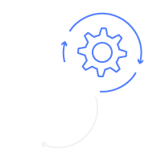
Compute environments
Managed
Unmanaged
AWS scales and configures your instances for you.
Optional choice:
On demand/Spot
Instance types/mix
Amazon Machine Image (AMI)
You control and manage the instance configuration, provisioning and scaling.
Full control over scaling and instance provisioning for the ECS cluster used by AWS Batch.
Notes:
The job queues that you created are mapped to one or more compute environments (CEs). You can think of a compute environment as a pool of resources/instances, that your jobs use. There are two types of compute environments: managed compute environments and unmanaged compute environments.
For managed compute environments:
you are giving Batch some guardrails. You are telling us the min and max and desired number of vCPUs in aggregate.
You are also telling us which instance types you would like us to launch on your behalf.
You can specify instance families to launch any instance type within those families (for example, c5, c5n, or p3), or you can specify specific sizes within a family (such as c5.8xlarge).
You can be either very prescriptive and say only launch C4.8xl instances, or select “optimal” and let Batch figure out the best instance type and size for you, base on your job size and cost.
If you want to use Spot Instances, in your CE, you have the option to tell us what percentage of on-demand pricing you would like us to set as a cap to control your cost, meaning if the current Spot price is at 30% of on-demand price, you have the option to set say 50% as the cap.
If Spot market price exceeds 50% of on-demand price, we will terminate these instances for you to control cost.
After you have provided these guardrails, we will start to launch compute resources in response to the arrival of jobs and the resource requirements of those jobs. For example If you have a lot of memory intensive jobs we'll start launching instances that have appropriate amounts of memory for these workloads. If you have CPU intensive workloads that don't need as much memory, we can run those on compute resources that are more appropriately sized for those jobs.
And because we’re running your jobs within Docker containers, we have the ability to write multiple jobs concurrently on the same host and so we get more efficiency gains in the execution of those jobs on top of your ec2 instances. The instances that we launched are launched within your AWS account, so you'll see these popping up in the ec2 console and you have the ability to to interact with them if you like.
For example, if you create a managed CE and set 0 as your min vCPU, 2 as your desired vCPU, and 128 as the max vCPU, Batch will scale up 2 vCPU worth of instance (depending on the instance type you selected) at first regardless of whether you have any job in the queue, then we will scan the queue every 10 minutes to see how many jobs are there, if we see lots of jobs, we will scale up more instances up to the max number of vCPUs set by you. If we don’t see any jobs in the queue, we will scale down to the min number of vCPUs set by you. In this case, we will kill all instances because your min vCPU is 0. When you submit more jobs later, we will scale up again.
unmanaged compute environment:
Most of our customers are happy with using managed compute environments. But there are some categories of users who have resource requirements that go beyond what we're going to be providing in our managed CE at this point , and so those users should use unmanaged compute
Environments.
You can think of an unmanaged compute environment as being very similar to an ECS cluster. Not sure if you are familiar with ec2 container service, you can think of a ECS cluster is a logical representation of a collection of compute resources. If you create an unmanaged compute environment we will then create a ECS cluster for you. You can launch your instances of an ami that has the ECS agent installed running a compatible version of Linux. Once those instances are launched and registered with the ECS cluster we've created for you, are accessible and we'll start scheduling jobs to those to those compute resources. With unmanaged compute environments, you have the ability to attach terabytes of EBS storage to each of your compute resources. You can also attach EFS file systems, lustre, Orange, any network file system of your choice to these instances. Unmanaged CE also allows you to also take advantage of dedicated instances or a number of other ec2 features so effectively giving you custom ec2 instances on which we can schedule your jobs. Again, the difference between managed and unmanaged CEs lied in who manage the underlying instances.
Alternatively, you can launch and manage your own resources within an Unmanaged compute environment. Your instances need to include the ECS agent and run supported versions of Linux and Docker.
AWS Batch will then create an Amazon ECS cluster which can accept the instances you launch. Jobs can be scheduled to your Compute Environment as soon as your instances are healthy and register with the ECS Agent.

Slide 69
Thank you!
GM, Container Services
Bob Wise

